Slide 1
E-Safety Team assembly

Slide 2
Going Online
Talk About It
When do you go online? Why do you go online?
We go online for lots of reasons including:
watching TV shows
playing games
watching online videos
talking to friends
finding out things
homework
The Internet can be loads of fun!
Florence

Slide 3
But…
Who do you think owns the Internet?
Who do you think decides what can be put on to it?
Who makes sure the things on the Internet are truthful and real?
Answer: No one owns the Internet. No one decides what can be put on.
The Internet can be used by everyone and everyone can add things to it!
Think About It
Trust means to be able to count on someone and know they are telling the truth. Do you think you can trust everything and everyone on the Internet?
Greta

Slide 4
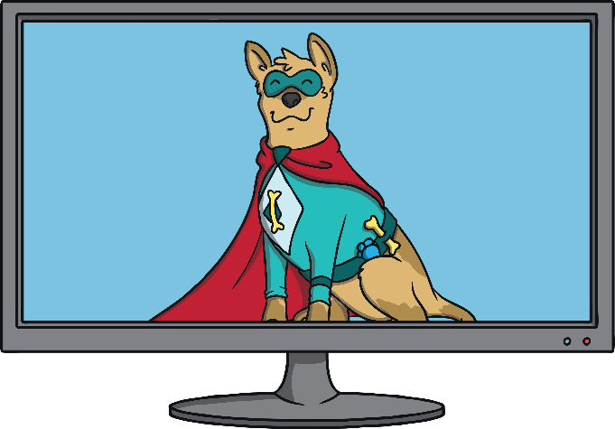
Would You…?
What do you think about the situation below?
What would you do?
If a stranger came up to you in the street, talked to you and asked you to go with them because they had something really good to show you, would you go?
Nico

Slide 5
Would You…?
Here are some important things to remember when you are online.
Just like in the real world, the Internet has both nice and unkind people using it.
There might be people who want to help you and there may be people who may want to trick you or be unkind to you. But you can’t see the people using the Internet and it is hard to tell who is trustworthy and who isn’t.
Even a photo of the person could be a fake photo of someone else!
Daniel

Slide 6
Stay Safe Online
Remember, anyone can use and add things to the Internet. This means that we can’t always trust what we see on it.
We can’t always trust that people who want to talk to us on the Internet are trustworthy.
We can’t always trust the websites on the Internet. Some may have viruses that can stop our computers from working properly!
So, how can we use the Internet for all the fun things but still stay safe?
Lucy

Slide 7
How To Stay Safe
Try to only use websites you know can be trusted. If you aren’t sure, ask an adult!
Try to use websites that are for children as much as possible such as kiddle.co or safesearchkids.com for searching the internet.
Remember, some people might pretend to be children to talk to you. Never give out your name or address! We don’t really know who we are talking to when we chat through the Internet.
Never arrange to meet an online friend. If someone online asks you to meet them, tell an adult you trust right away.
Remember if you aren’t sure about anything, always ask a trusted adult.
James

Slide 8
Bullying
Talk About It
What is bullying?
Bullying is when a person tries to hurt someone on purpose, either in what they say or what they do. This doesn’t happen once, it keeps happening again and again.
Some people use the Internet to bully others. This is called online bullying.
Greta

Slide 9
Online Bullying
Online bullies may:
send nasty text messages or emails,
say unkind things about people on social networking sites,
try to get others to say unkind and nasty things too,
send unkind photographs to lots of people.
Online bullying hurts people just the same as any other bullying.
Florence

Slide 10
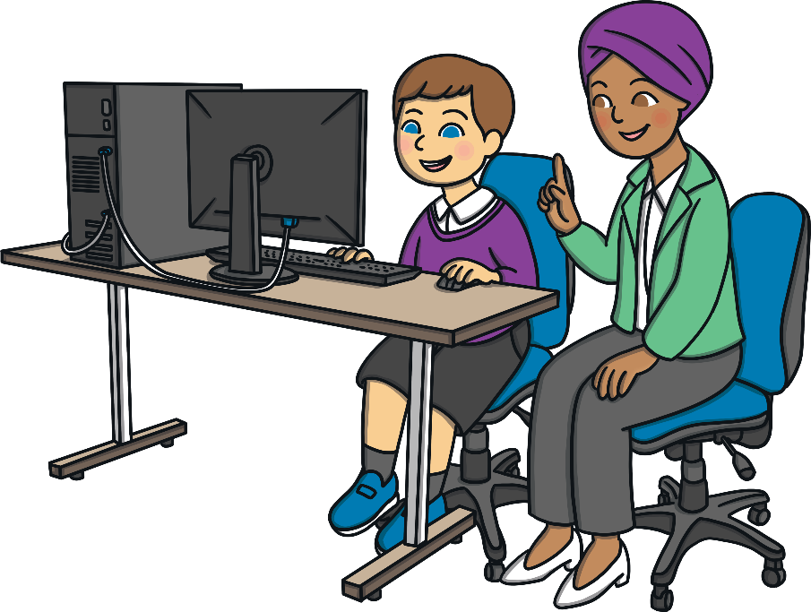
What If You See Something Upsetting Online?
The most important thing to remember is, if you see something that upsets you, tell an adult you trust right away. It might be a grown-up you live with or a teacher at school.
They can help you to report the thing you saw.
They can talk to you help you feel safe.
They can help to stop the bullies hurting other people too.
No one has the right to hurt or upset anyone else, even online!
Nico

Slide 11
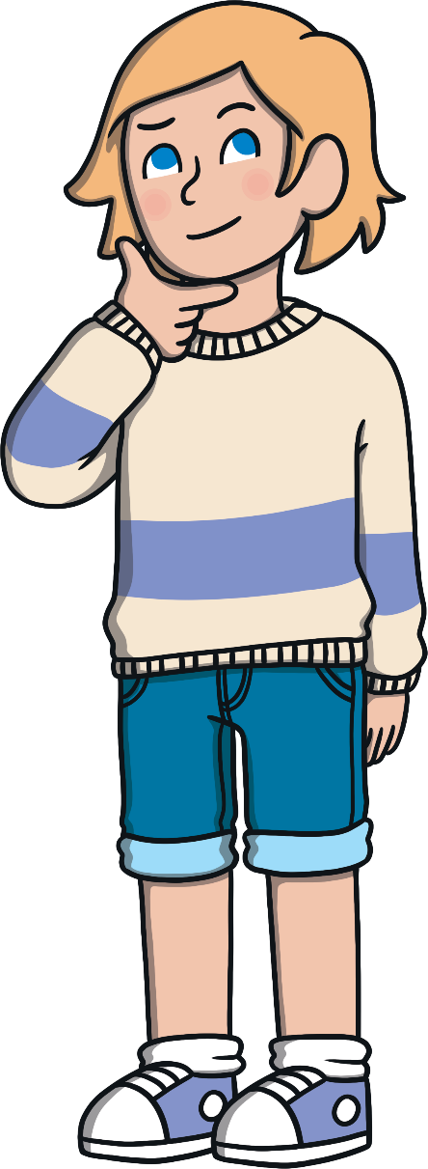
What Should You Do?
If you see someone else being bullied online, do not join in or be nasty to the bullies. Tell an adult.
Do not write unkind things about other people or use nasty words. You can’t see the person but it will still hurt them!
Daniel

Slide 12
Remember to Be SMART
Stay Safe: Never give your name, address or passwords out to anyone online. They may say they are the same age as you but they could be lying.
Meet: Never go to meet someone you have made friends with online. If an online friend wants to see you, talk to an adult. Remember that they might not be who they say they are.
Accepting: If someone sends you a photo or a file, ask an adult before you open it. It could have a virus. Don’t accept it!
Reliable: Remember that you can’t trust everyone who uses the Internet. Not everyone is kind or trustworthy.
Tell: Tell an adult if something online upsets you or makes you worried.
Lucy/James/Lucy/James/Lucy

