Slide 1
Understanding worry Mental Health Support Team
Rachael Keat & Bella Birrell

Slide 2
Introductions….
Who we are
What we do
What we are going to cover today
Notes:
Names; our service (work with schools, families and children – offering advice, resources, sounding boards as well as individual or group support);
Today – mental health is a huge field but chosen to look at the main issue amongst primary school children (and all ages) – anxiety and worry; look at what it is, how it is maintained or kept going and some strategies that we can use to help manage and reduce anxiety and worry

Slide 3
What is Anxiety?

Slide 4
Anxiety is normal
Anxiety is a normal emotional response that we all experience and in the right amounts it can be useful…

Slide 5
main characteristics of anxiety
Physiological – prepares the body for action (fight, flight or freeze); increased physiological arousal (can be misunderstood as evidence as something bad going to happen)
Cognitive – check situations and events for anticipated risk; often over-estimate danger and under-estimate ability to cope; “worry” about school, health, other people, spiders etc.
Behavioural – behaviours are aimed at trying to help anticipate and/or avoid danger e.g. hypervigilance, avoidance, safety behaviours.
Notes:
All three aspects can be useful when there is real danger or threat – they prepare our body, thinking and behaviour to keep us safe; however all aspects are problematic when there is no real danger. We are left feeling shaky, thinking and imagining the worst and then unable to get on and do the things we want to or need to do. But the good thing is, all three aspects can be managed and changed.

Slide 6
When does anxiety become a problem?
Persistent – worrying more often than not, over weeks and months.
Excessive – when it is disproportionate to the situation.
Difficult to control – feels overwhelming.
Interferes – when everyday life is impacted
Notes:
So how do we know when our anxiety is a normal, useful part of being human and when does it become a problem?
It becomes a problem

Slide 7
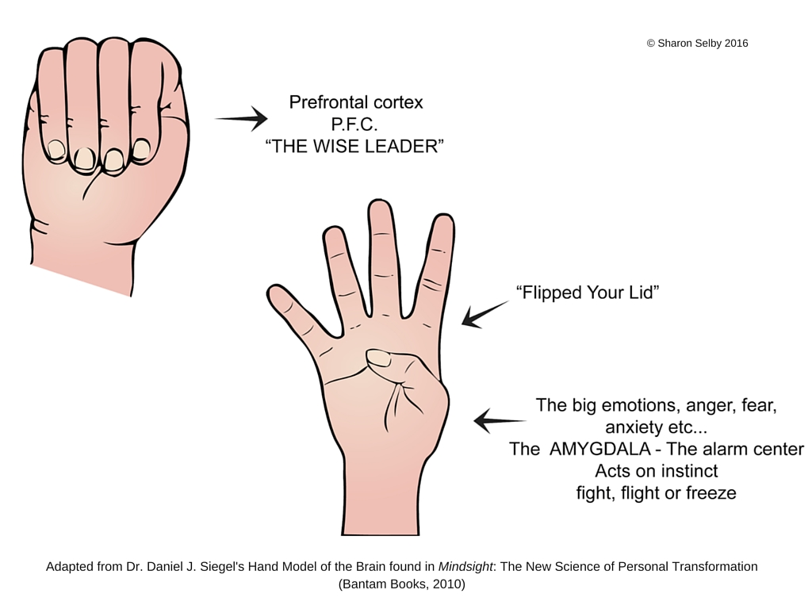
Understanding what happens in the brain
Notes:
I think it's also useful to understand what's happenning in our brain, when we're anxous and this is an example that I use with children, that you might find helpful to use in explaining to them.
It's an example from a man called Dan Siegel, who does actually explain it much better than I do. If you are interested in finding out more about your child's brain, he's a guy thats definitely worth checking out,

Slide 8
Anxiety
Over estimation of the actual danger
Under estimation of ability to cope
Notes:
Put very simply, anxiety is almost always imagining the worst – overestimating the actual danger, risk or bad outcome and thinking that you are unable to cope.

Slide 9
Fight/Flight/Freeze response

Slide 10
Common fears
Notes:
Many worries and fears that children experience are absolutely a natural part of their development: they are hard-wired to stay close to their caregiver from birth, it keeps them safe (and alive!), this should reduce from about the age of 3 onwards; as their idea of the world changes, they take on new worries (strangers, monsters, what others think of them, their school performance etc). Our job is to listen to their worries with interest and help them learn that the world they live in is mostly a safe place and that they are able to cope with most things that happen.

Slide 11
Notes:
Many worries and fears that children experience are absolutely a natural part of their development: they are hard-wired to stay close to their caregiver from birth, it keeps them safe (and alive!), this should reduce from about the age of 3 onwards; as their idea of the world changes, they take on new worries (strangers, monsters, what others think of them, their school performance etc). Our job is to listen to their worries with interest and help them learn that the world they live in is mostly a safe place and that they are able to cope with most things that happen.

Slide 12
Common themes in parents / caregivers
Things that might keep a child’s anxiety going
Demonstrate anxious behaviour (passing on our own fears)
React to the child in an anxious way
Become very involved and protective
Reassure them – maybe too much?
Little encouragement to try / do things – e.g. don’t encourage or praise brave behaviour
Notes:
Before looking at strategies that we can use to help our children manage their anxiety and worry – we can notice the part we play in their anxiety – not at all blaming ourselves – we too are hard-wired to protect, help and keep our children safe – but it is useful to be aware of what we might be doing that is infact keeping the anxiety going….

Slide 13
Safety behaviours
AVOID
ESCAPE
REASSURANCE
Notes:
Examples: avoid – not going to school escape – going in but going home sick if anxiety rises reassurance – asking parents lots of what if questions
Problem with all of these behaviours is that they take away the opportunity to learn that the danger isn’t as bad as we thought, the opportunity to learn that even if the worst thing happens we can actually cope with it and they teach that they only way to cope is to avoid, escape or continually have that reassurance, safety blanket – when in fact we don’t need any of these things.

Slide 14
The difference between Support & Reassurance/RESCUING
Notes:
As parents, our desire to make our children’s life easy and happy means that we often slip into rescuing and reassuring. It’s understandable. But it isn’t helpful. The aim is to support our children develop the skills needed to face challenges, feel confident enough to give things a go, learn that they can cope with difficulties, mistakes and tough times, that you will always be there to support but that you are not needed to solve all their problems or remove all difficulties.

Slide 15
Practical tools and strategies

Slide 16
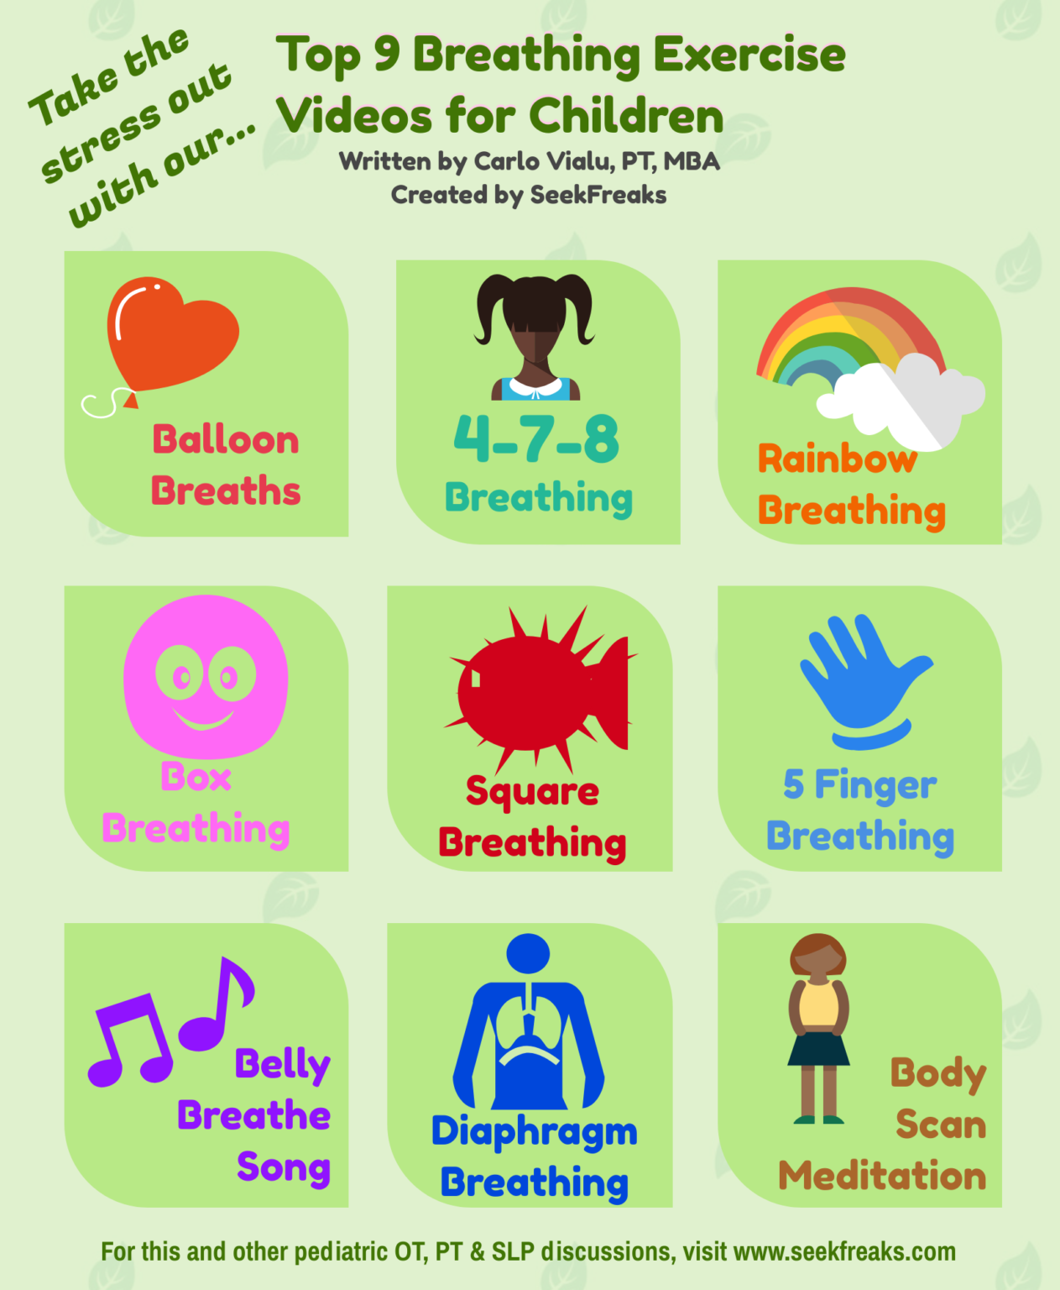
Breathing exercises
Imagine a balloon in your tummy
Breathing from diaphragm not shallow chest breathing
Breath out for longer than breathing in
Relaxed posture
Counting can help
Notes:
Breathing relaxes the nervous system, reduces the cortisol in the body, sends a message of calm and control to the brain, reduces your heart rate, lowers blood pressure. And if you focus on your breathing it also takes attention away from the worry.

Slide 17
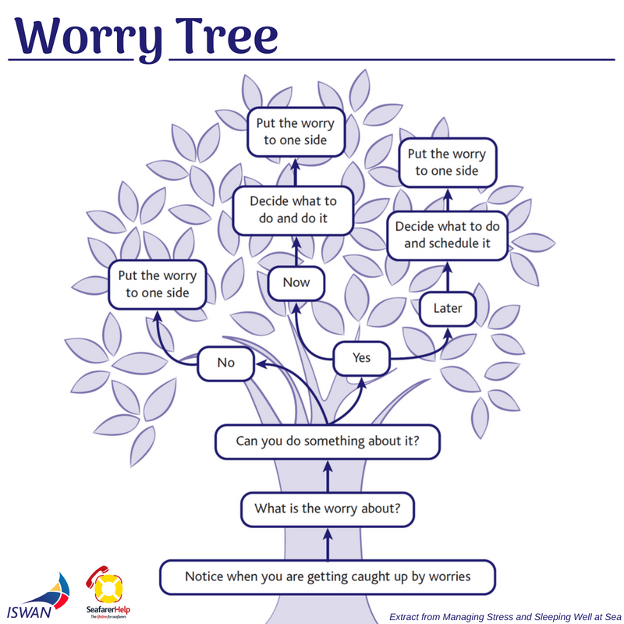
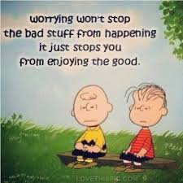
Worry tree
Notes:
Incredibly useful strategy.
Notice the worries and decide if you can do something about them – are they real or practical worries and if so, can you solve them yourself now (tell someone, change something, etc) or can you plan to do something about it another time or with the help of an adult? If you can’t do something about them (hypothetical worries – worries about the future, what if type worries) – put them to one side. Can use worry monsters for this, worry diaries or whatever works. Worrying about something you can’t change is a real waste of time, it achieves nothing – so we need to help our children to learn the very useful skill of putting our worries to one side if we can’t do anything about it or problem solving them if we can.

Slide 18
Progressive Muscle Relaxation
Psychoeducation – tension carried in muscles due to anxiety, need to practice releasing this from our muscles.

Slide 19
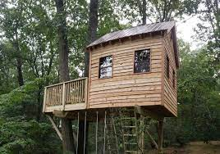
Safe place imagery
Notes:
For this to work, you need to really spend time imaging the safe place when feeling calm and settled – go through all the senses – what can you see in your safe place, what can you hear, what can you feel on your skin, what are the smells, the colours.

Slide 20
5 4 3 2 1
5 Things you can see
4 things you can touch
3 things you can hear
2 things you can smell
1 take a slow deep breath…breathe
Then focus on your breathing, before shifting your focus of attention onto something different....
Notes:
This has endless possibilities – this is the most common one, but can change it to suit your child…..find 5 things that are red, 4 things that are purple….find 5 things beginning with a, 4 things beginning with b…….find 5 straight things, 4 curvy things…..

Slide 21
Coping thoughts
Stop, and breathe, I can do this This will pass I can be anxious/sad/angry and still deal with this I have done this before, and I can do it again It’s okay to feel this way, it’s a normal reaction – it will pass These are just feelings, they will go away This won’t last forever | I can feel bad and still choose to take a healthy direction I don’t need to rush, I can take things slowly I have survived before, I will survive now Thoughts are not necessarily true or factual I can learn from this and it will be easier next time I can use my coping skills and get through this
Notes:
Help your child find a thought or two that is really meaningful to them….what do they need to remember, what makes them feel more in control or less anxious?

Slide 22
Graded
Notes:
This is the idea of facing our fears bit by bit. We can jump in at the deep end, but it can feel more manageable to take it slowly and learn more about ourselves, what helps and what doesn’t help at each step of the way.
As an example….

Slide 23
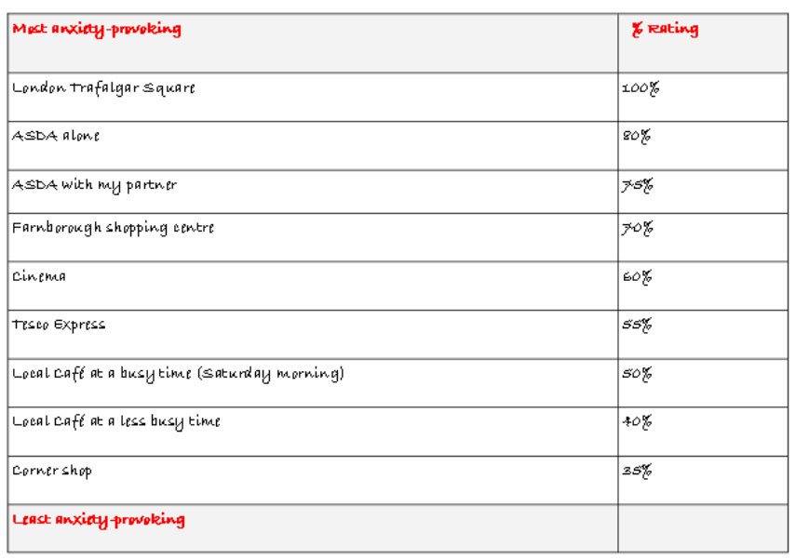
Example Hierarchy
Fear of crowded places
Notes:
Step 1: MAKE PLAN TO REDUCE ANXIETY – What is it that your child needs to learn or needs to change? Fully understand that short term relief of anxiety is only keeping it going in the long term. When calm and settled, agree a plan together.
Step 2: START PRACTICING – ‘Remember, this is just your anxiety trying to help you but it isn’t getting it right’. ‘I’m not going to answer that question as I want to help you defeat your anxiety gremlin/cope with anxiety, what can you do to focus on something else?’ ‘How can you cope with your anxiety?’ (suggest strategies, engage in another activity with child)
Step 3: LOTS OF PRAISE, FOCUS ON WHAT HAPPENED AND WHAT LEARNT e.g. went to school and coped, gave it a go, breathing helped.

Slide 24
RESOURCES FOR parents
Help Your Child with Worries, by Cathy Creswell
The Huge Box of Worries (younger children)
What to do when you worry too much (ages 7-11 approx.)
Starving the anxiety gremlin
‘Overcoming’ series
Cool connections with CBT
Think Good, Feel Good
CYMPH Booklet
From Timid to Tiger (parenting intervention)
Psychology in Schools Workshops: Psychology in Schools Team - NSFT Events | Eventbrite

Slide 25
ONLINE RESOURCES
Young minds
MIND
The Mix
National Self Harm Network
Get Self Help
Anna Freud Centre

Slide 26
APPS
FearTools: Provides information on anxiety and some ideas for ways to improve. Gives you a tool to create exposure to a fearful situation. Also includes a thought diary.
SAMapp: An anxiety app with information and ways to track you feeling anxious.
Worrytime: This app allows you to write down worries on your mind and put aside a short period where can think about them so they don’t sit on your mind.
PanicShield: Centred on panic, this app has information on what panic is and different ways in which you can expose yourself to what makes you panic.
MindShift: Allows you to pick scenarios you would like help with, improve thought patterns, and get information on anxiety in general. Has a rating scale for anxiety with what you feel when feeling anxious.
Calm: A relaxation app based on mindfulness. This app gives you relaxation tips breathing, meditation or attempting to sleep.
WellMind: Provides information and help for stress, anxiety and depression. Also contains relaxation audio clips.
Headspace: Meditation and relaxation app.
Notes:
Maddy

Slide 27
Any questions?
Notes:
Thank you for listening!

